Slide 1
Analytics & Visualization
Day 3 · The Haunted Snack Bar, then five years of seasonal data
Sobey High School Co-Op · Business Analytics & AI · Friday, October 30, 2026

Slide 2
What we're doing
TODAY
Recap
three Day 2 mistakes and the one-line fix for each
Notebook 1 · The Haunted Snack Bar
type along: variables, lists, for, if / elif / else, functions, while, dictionaries, a DataFrame
The notebook
the tools you just used, the pipeline from question to decision, and why we draw charts
Notebook 2 · The Seasonal Workbook
five years of Google Trends for eight seasonal products, plus Halloween spending: seven chart types, one question each
Season maths
peak week, stock-up week, season length: three numbers every seasonal business needs
Pitch the season
teams of 2 or 3, one lane each: a stocking decision backed by 2 or 3 charts, title + 3 slides
Presentations
3 minutes per team, in season order, then the takeaway
Everyone runs their own copy of both notebooks. The pitch is in teams.

Slide 3





Five things you can do by the end of today
BY 1 PM
Write eight Python ideas
a variable, a list, a loop, an if, a function, a while, a dictionary, a DataFrame: typed by you, not pasted
Load and summarize real data
2,096 weeks of Canadian searches in a table you control with code
Pick the right chart
line, bar, grouped bar, histogram, box plot, scatter, heatmap: one question each
Spot a misleading chart
and fix it: a zero baseline, a title that states the finding, a source line, a limit said out loud
Make a seasonal decision
"We built a program that analyzes and visualizes data to support a business decision."

Slide 4
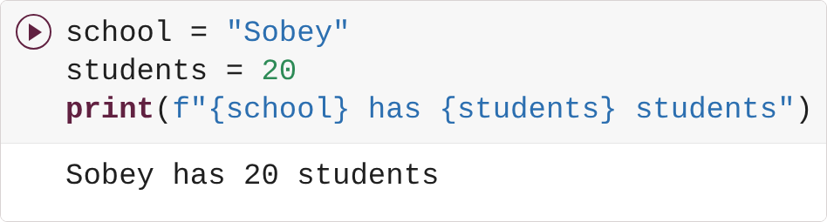
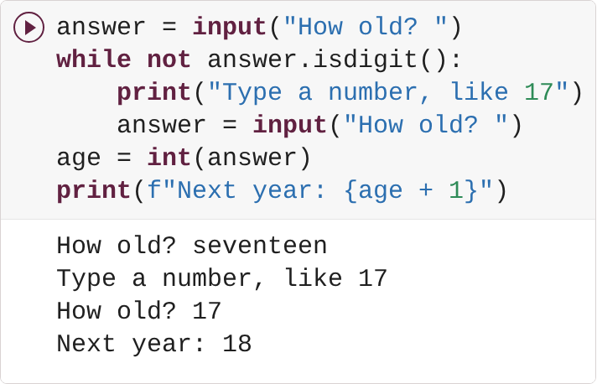
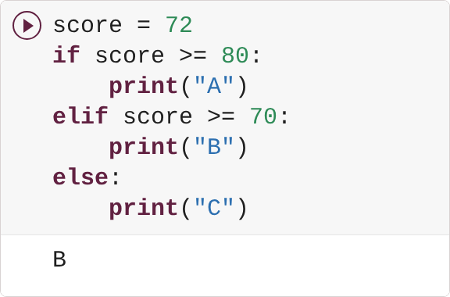
Three mistakes from last week, and the one-line fix for each
RECAP · DAY 2
FORGOT THE f
int() CAN'T READ "seventeen"
= STORES, == COMPARES
Mistake: print("{school} has {students}") printed the braces, no error.
Mistake: ValueError. Fix: a while loop that asks again.
Mistake: if score = 80 (SyntaxError) and a body that wasn't indented.
Habit: read the last line of an error first, then check that the output is what you meant, not only that it ran.

Slide 5
The Haunted Snack Bar: eight cells, typed by you
01

Slide 6
Eight words you'll use all day, in the order you'll type them
PYTHON BASICS · THE WORDS
1
Variable
a named box that holds one value
2
List
many values in order, inside [ ]
3
for loop
do the same thing to every item in a list
4
if / elif / else
the program chooses between paths
5
Function
a recipe with a name: give it ingredients, it returns an answer
6
while loop
keep going as long as a condition is true
7
Dictionary
look values up by name, inside { }
8
DataFrame
a whole table pandas can sort, filter, group and chart

Slide 7
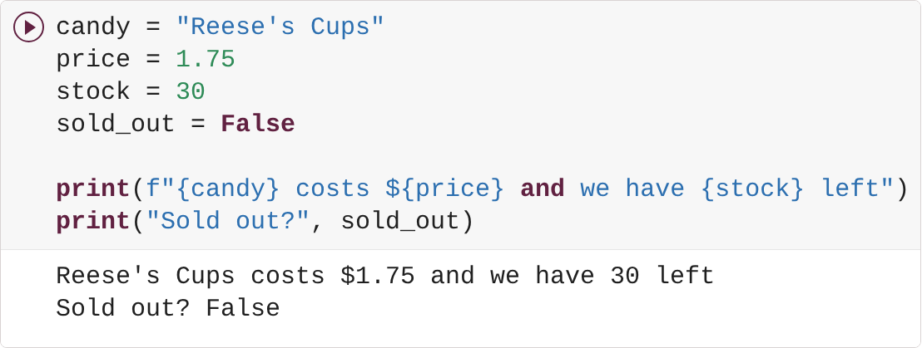
A variable is a named box: put a value in with =, use the name later
PYTHON BASICS · 1 VARIABLES
Four boxes: candy holds text (quotes), price a decimal, stock a whole number, sold_out a True/False. The f before the quotes lets {candy} and {price} drop their values into the sentence.
WHAT YOU SEE
One real sentence about the snack bar, built from four boxes.
Change one thing: stock = 0 and sold_out = True; then your favourite candy.

Slide 8
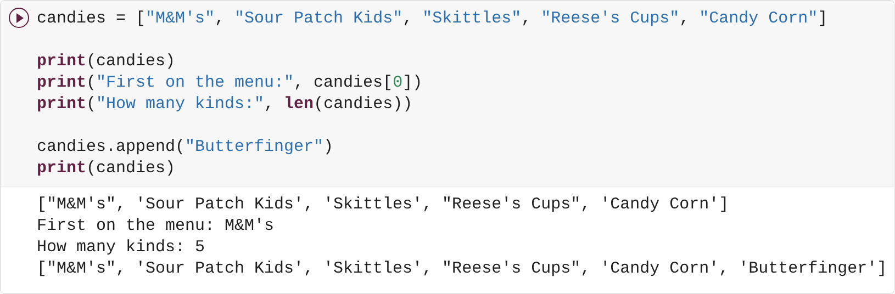
A list holds many values in order; Python counts from 0
PYTHON BASICS · 2 LISTS
Square brackets make a list. candies[0] is the first item because Python starts at 0. len counts the items; append adds one to the end.
WHAT YOU SEE
The list printed twice: five candies, then six after append.
Change one thing: candies[0] → candies[-1] (the last one); append your favourite instead.

Slide 9
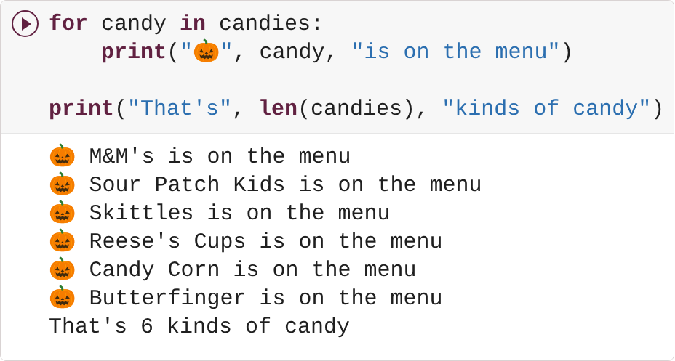
A for loop does the same thing to every item in the list
PYTHON BASICS · 3 FOR LOOPS
for candy in candies: runs the indented line once per item, with candy holding the next one each time. The un-indented print runs once, after the loop.
WHAT YOU SEE
One line per candy, then the count.
Change one thing: Add a candy to the list in cell 2 and run both: one more line with no new code. Then 🎃 → 👻.

Slide 10
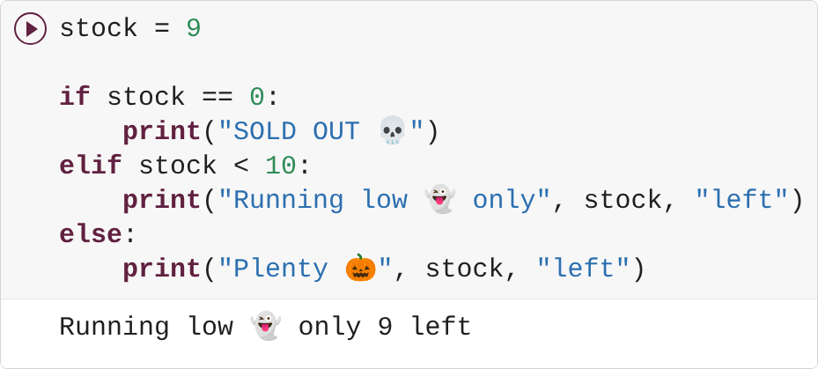
if, elif and else let the program choose; exactly one path runs
PYTHON BASICS · 4 IF / ELIF / ELSE
Python checks the questions from the top and runs the first one that is true. == asks 'is it equal?'; a single = puts a value in a box. 9 is not 0, but it is under 10, so the middle path runs.
WHAT YOU SEE
One message, chosen by the number.
Change one thing: stock = 0, then stock = 40, then change the 10 to 20.

Slide 11
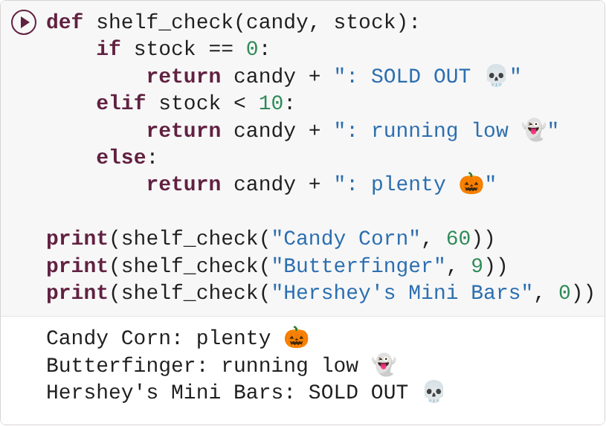
A function wraps the check so you can run it on any candy in one line
PYTHON BASICS · 5 FUNCTIONS
def makes a recipe called shelf_check that needs two ingredients. Inside is cell 4's if / elif / else, using whatever stock was handed in. return sends the answer back. Three calls, three answers, one recipe.
WHAT YOU SEE
Three candies checked with one function.
Change one thing: Add a fourth print with your own candy; then change < 10 to < 50.

Slide 12
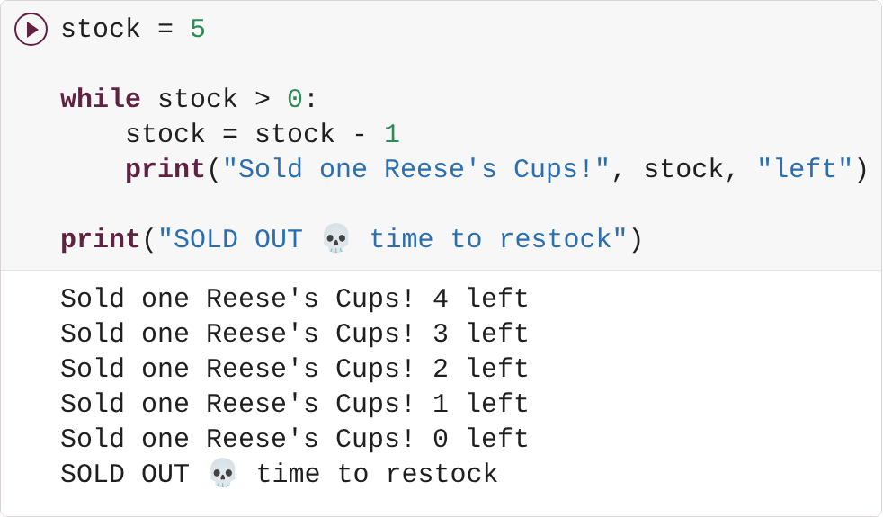
A while loop keeps going as long as the condition is true
PYTHON BASICS · 6 WHILE LOOPS
A for loop runs once per item. A while loop runs while stock > 0 is true, so something inside has to change: stock = stock - 1 takes one off the shelf each time round. When it hits 0 the loop stops and the last line runs.
WHAT YOU SEE
Five sales, then sold out.
Change one thing: stock = 10 and sell two at a time (stock - 2); then stock = 3.

Slide 13
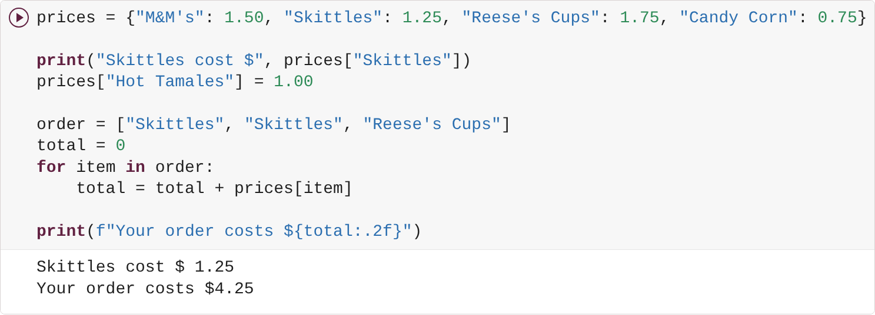
A dictionary looks a value up by its name: a price list
PYTHON BASICS · 7 DICTIONARIES
Curly brackets; name, colon, value. prices["Skittles"] looks up by name. A new name-and-price pair is added with one line. Then cell 3's loop and cell 6's add-up work together: for every item in the order, look up its price and add it on.
WHAT YOU SEE
A price lookup, then an order total with two decimals.
Change one thing: Add "Candy Corn" to the order; raise the price of Reese's Cups.

Slide 14
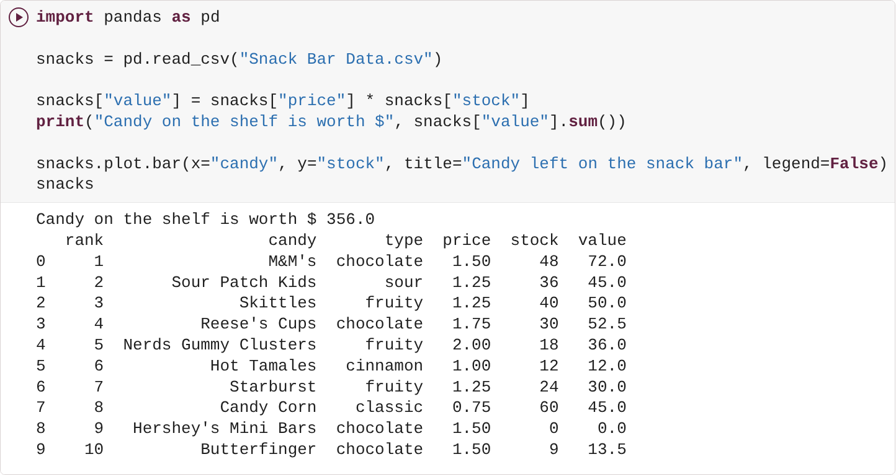
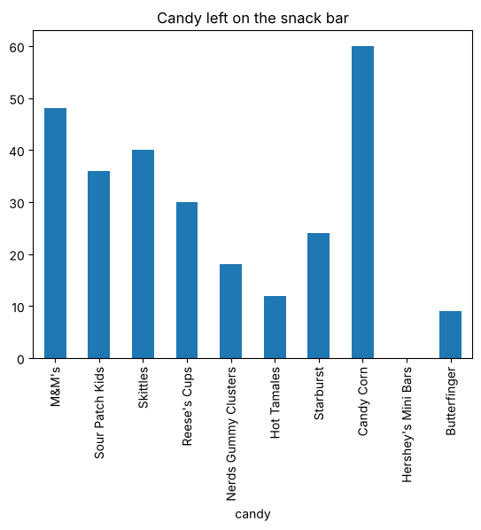
pandas reads the whole file into one variable: a table with named columns
PYTHON BASICS · 8 DATAFRAMES
read_csv turns the uploaded file into a DataFrame. A column times a column makes a new column for every row at once, no loop. .sum() adds a column up. One line draws the chart; a variable on its own as the last line shows the table.
WHAT YOU SEE
The 10 most popular Halloween candies (a real 2026 ranking), the shelf's value, and your first chart.
Change one thing: y="stock" → y="value"; .sum() → .max().

Slide 15
The notebook: what you just used, and why charts
02

Slide 16



Five tools, one job each, and where you already used them
THE TOOLS
Python
the language: the instructions you typed in cells 1 to 7
Google Colab
runs Python in your browser; the Files panel is where the CSV went
pandas
tables you control with code: read_csv, a new column, .sum() in cell 8
matplotlib
draws any chart, piece by piece: cell 8's bar chart used it behind the scenes
seaborn
statistical charts in one line: box plots and heatmaps, coming up in Notebook 2

Slide 17
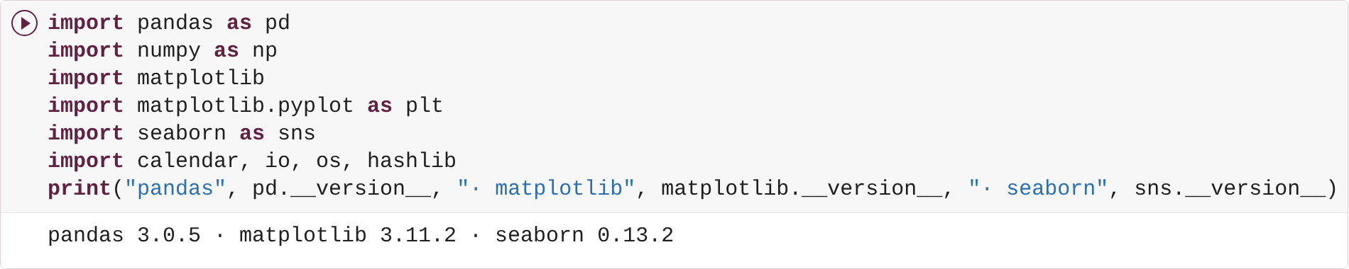
Import once, print the versions, then every chart uses the same house style
THE TOOLS
WHY PRINT VERSIONS?
Different versions can draw a chart differently. Printing them makes your run checkable.
Versions shown: the run that produced the answer sheet.
THE HOUSE STYLE
One ready-made cell sets colours, fonts and a finish() helper: a title that states the finding, a source line, a saved PNG.

Slide 18
Six steps: question, load, clean, analyze, visualize, decide
THE ANALYTICS PIPELINE
Question
Load
Clean
Analyze
Visualize
Decide
When should a store stock up for its season, and for how long?
2,096 weeks of Canadian searches, eight lanes; 22 years of Halloween spending
text dates become real dates; partial years get flagged, never hidden
groupby by month and year; peak week, stock-up week, season length
seven chart types, one question each
stock date, ad start, markdown date, and how to check it
Cell 8 was the whole pipeline in miniature: a question (what is on the shelf worth?), load, a new column, a sum, a chart. Notebook 2 is the same shape with 2,096 rows.

Slide 19
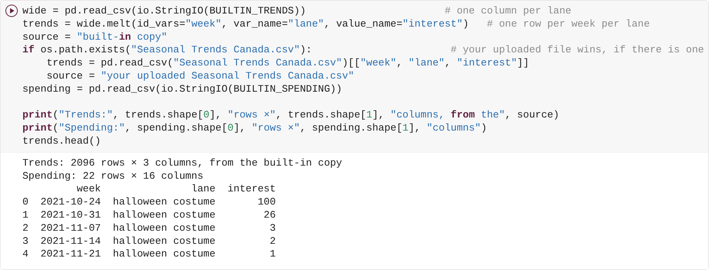
pandas reads 2,096 weeks of real searches; a fingerprint proves the file
THE NOTEBOOK · READING DATA
TWO TABLES
WHAT A SCORE MEANS
Feeds: every chart in the gallery and your lane in section 6.
Trends: 2,096 rows (week, lane, interest) and NRF spending (22 years). melt turns one column per lane into one row per week per lane, the shape groupby wants.
100 = that lane's busiest week; 50 = half as busy. Relative interest, not a count, not sales.
Source: Google Trends, Canada, web search, weekly, Oct 24, 2021 to Oct 25, 2026; relative interest 0 to 100 per lane; read Oct 29, 2026

Slide 20
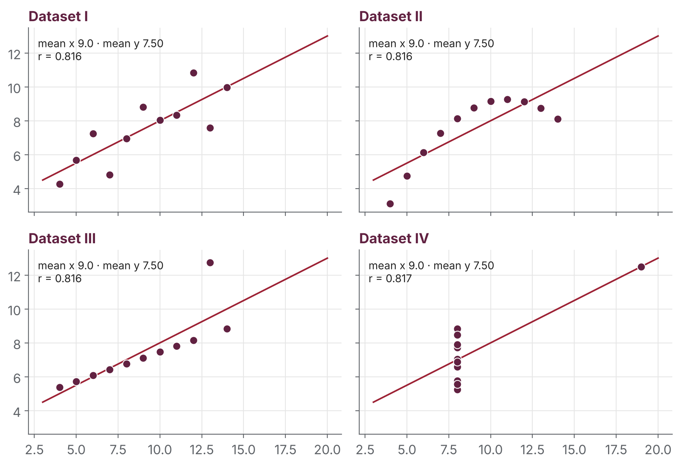
Four datasets, identical averages: only the charts show the difference
WHY VISUALIZE
THE SAME FOR ALL FOUR
mean of x
9.0
mean of y
7.50
correlation r
0.816
points
11 each
So: always look at the data, not only its averages.
Source: F. J. Anscombe (1973), "Graphs in Statistical Analysis", The American Statistician 27(1); data as published in seaborn-data (anscombe.csv). Charts drawn by us.

Slide 21
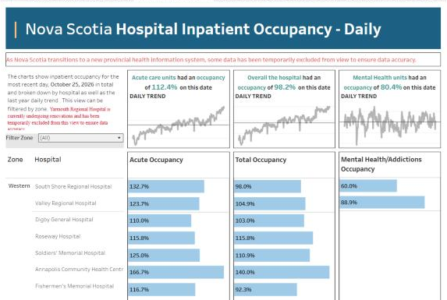
Nova Scotia Health puts hospital occupancy on a public dashboard
WHY VISUALIZE · A REAL DASHBOARD
1
Headline numbers
Acute care units at 112.4% occupancy on Oct 25, 2026
2
Trend lines
a small daily trend under each number
3
Bars per hospital
grouped by health zone, filterable
4
An honest limit
the banner says some data is left out for now
Source: Nova Scotia Health, Action for Health – Public Reporting, "Hospital Inpatient Occupancy – Daily" (Tableau Public), data for Oct 25, 2026; screenshot Oct 27, 2026.

Slide 22
The chart gallery: one question per chart
03

Slide 23
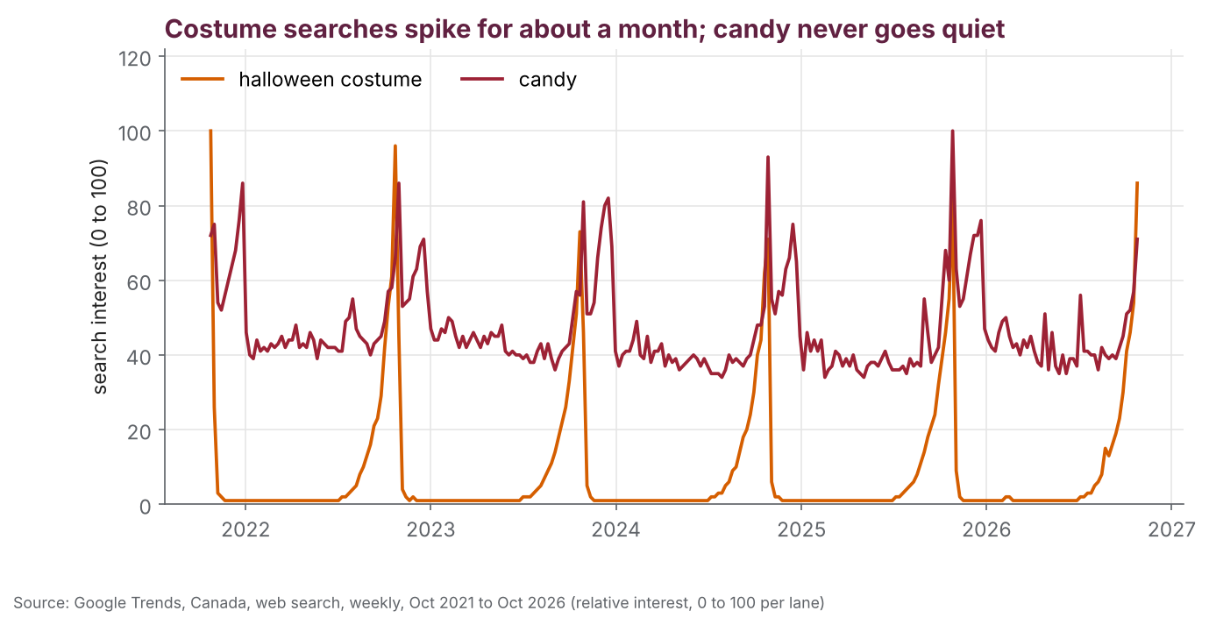
Costume searches spike for about a month; candy never goes quiet
CHART GALLERY · 1 LINE
THE QUESTION
When does Halloween start on Google?
MATPLOTLIB
ax.plot(one["week"], one["interest"],
color=COLOURS[lane], label=lane)
WHAT WE CAN INFER
Costume interest is near zero for ten months, climbs through September and explodes in the last two weeks of October, the same shape every year. Candy sits between 35 and 60 with two bumps: Halloween and Christmas.
THE LIMIT
Relative interest, not sales: we know when people search, not how many or what they bought.
Source: Google Trends, Canada, web search, weekly, Oct 24, 2021 to Oct 25, 2026; relative interest 0 to 100 per lane; read Oct 29, 2026

Slide 24
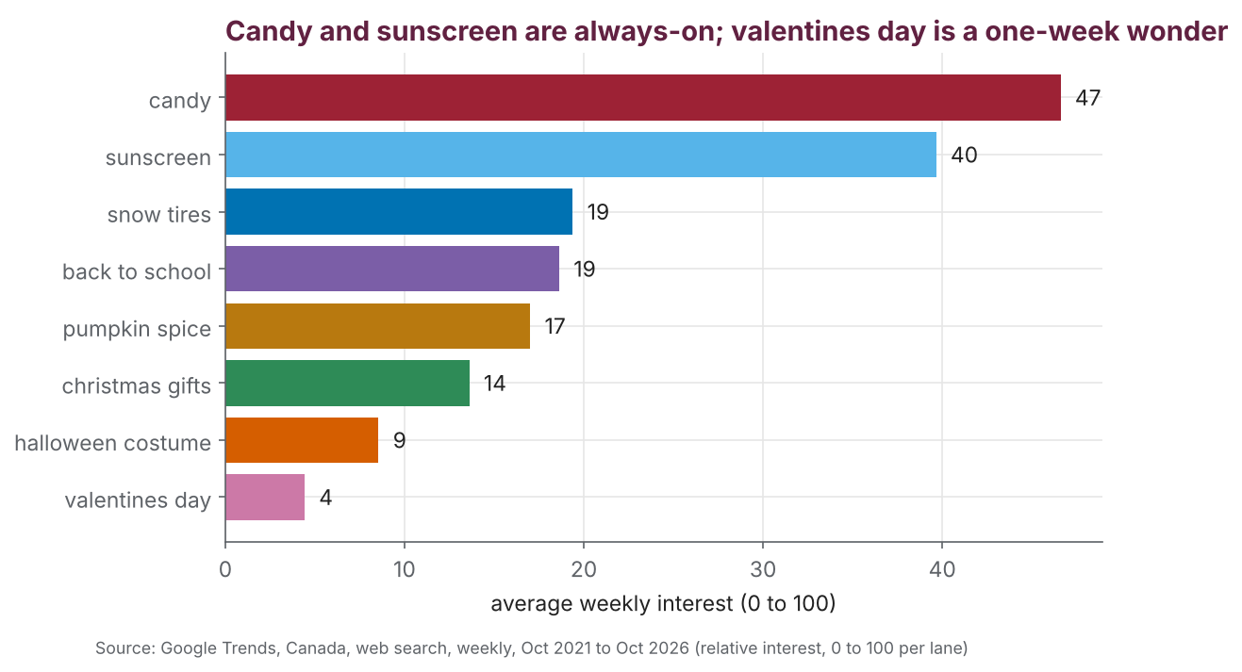
Candy and sunscreen are always-on; valentines day is a one-week wonder
CHART GALLERY · 2 BAR
THE QUESTION
Which lanes are always-on and which are spikes?
MATPLOTLIB
means = trends.groupby("lane")["interest"].mean()
ax.barh(means.index, means.values)
WHAT WE CAN INFER
The average tells you how spread out a season is. A store in a spike lane lives or dies on timing; an always-on lane needs steady stock and a plan for the bumps.
THE LIMIT
An average hides when. The heatmap answers that.
Source: Google Trends, Canada, web search, weekly, Oct 24, 2021 to Oct 25, 2026; relative interest 0 to 100 per lane; read Oct 29, 2026

Slide 25
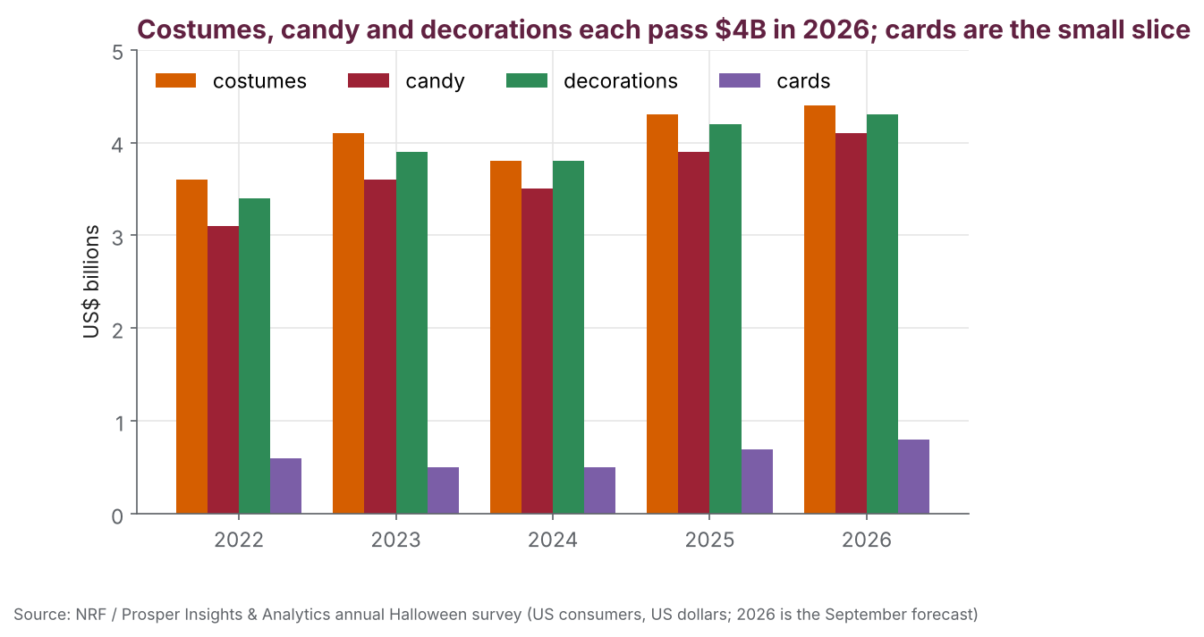
Costumes, candy and decorations each pass $4B; cards are the small slice
CHART GALLERY · 3 GROUPED BAR
THE QUESTION
Where does the Halloween dollar go?
PANDAS + MATPLOTLIB
recent.plot.bar(ax=ax, width=0.8) # one bar per
# category, grouped by year
WHAT WE CAN INFER
Three categories of roughly equal size, all growing, with a dip in 2024 (the $11.6B year). 2026: costumes $4.4B, candy $4.1B, decorations $4.3B, cards $0.8B.
THE LIMIT
US shoppers, US dollars, a survey forecast each September. Canada will rhyme with it; we do not have the Canadian number.
Source: NRF / Prosper Insights & Analytics annual Halloween consumer survey (nrf.com Halloween Data Center); US consumers, US dollars; 2026 is the September forecast

Slide 26
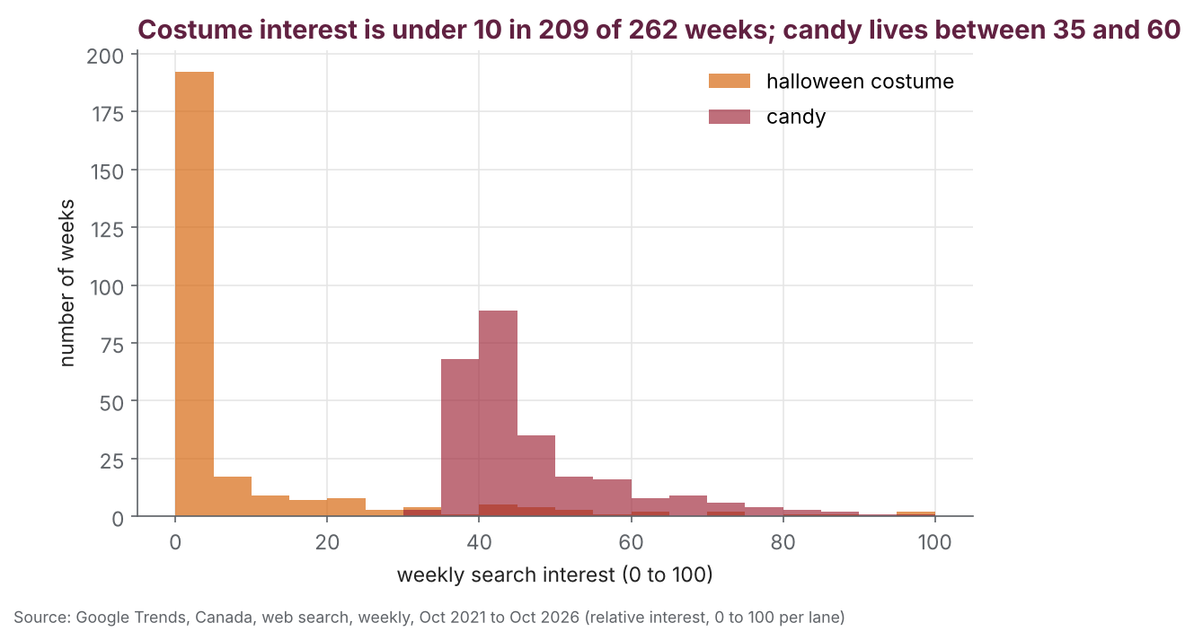
Costume interest is under 10 in 209 of 262 weeks; candy stays 35 to 60
CHART GALLERY · 4 HISTOGRAM
THE QUESTION
How many weeks a year are actually busy?
MATPLOTLIB
ax.hist(one["interest"], bins=range(0, 105, 5),
alpha=0.65, label=lane)
WHAT WE CAN INFER
The shape of a season. A tall bar at the left plus a long tail is a spike business; a hump in the middle is a steady one. Costume scores above 50 in only 12 weeks out of 262.
THE LIMIT
Bins too narrow turn spiky and the shape disappears; bins too wide hide the tail. We used 5.
Source: Google Trends, Canada, web search, weekly, Oct 24, 2021 to Oct 25, 2026; relative interest 0 to 100 per lane; read Oct 29, 2026

Slide 27
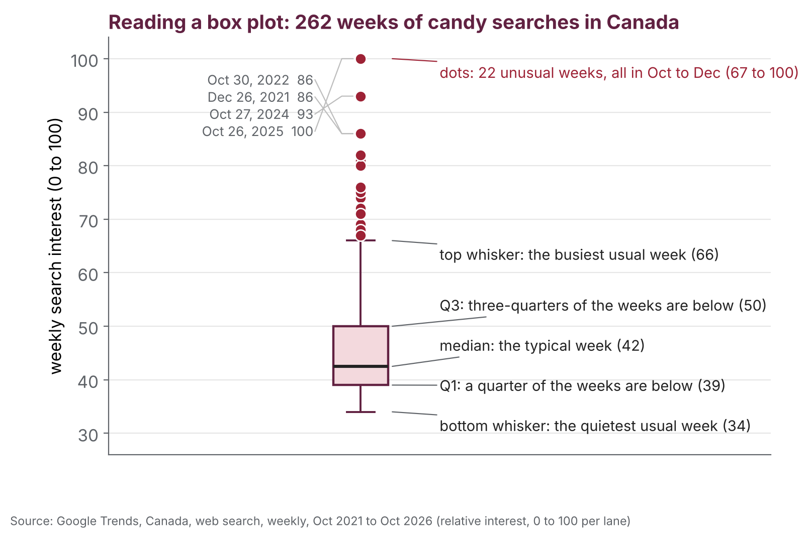
How to read a box plot: the middle half in a box, the median as a line
CHART GALLERY · BOX-PLOT ANATOMY
Box
the middle half of the weeks
Line in the box
the median: the typical week
Whiskers
the rest of the usual weeks
Dots
unusual weeks, shown one by one: here, the season
Source: Google Trends, Canada, web search, weekly, Oct 24, 2021 to Oct 25, 2026; relative interest 0 to 100 per lane; read Oct 29, 2026

Slide 28
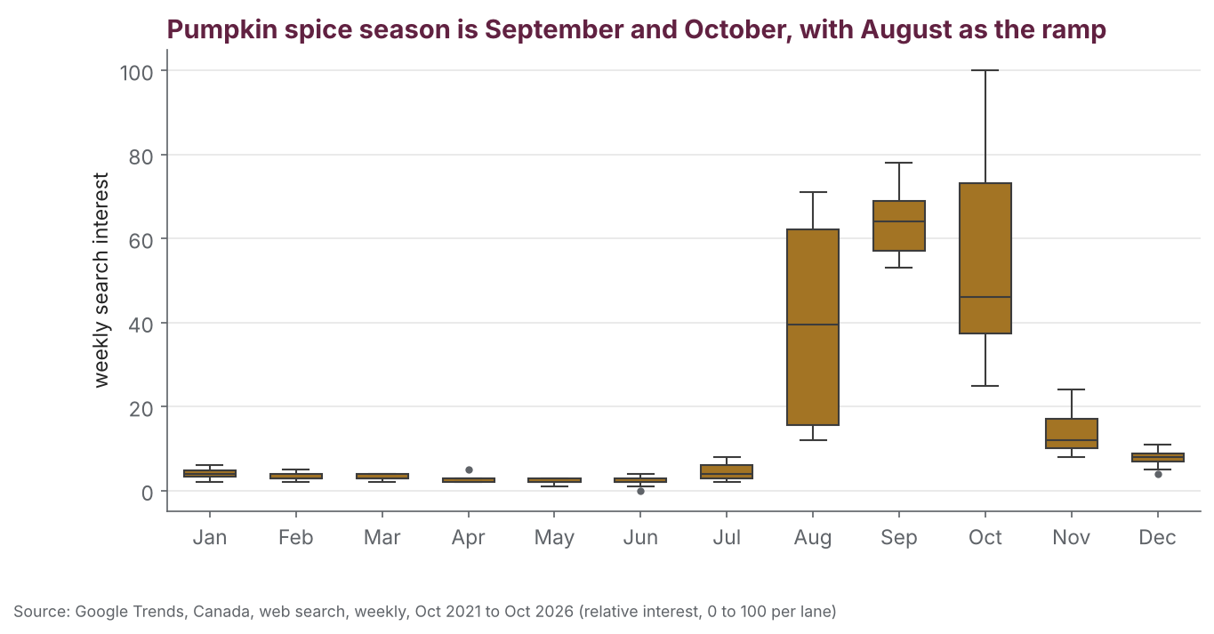
Pumpkin spice season is September and October, with August as the ramp
CHART GALLERY · 5 BOX PLOT
THE QUESTION
Which month, and how sure are we?
SEABORN
sns.boxplot(data=one, x="month_name",
y="interest", order=MONTHS)
WHAT WE CAN INFER
August's box is short and low but its whisker is tall: most August weeks are quiet, a couple are already busy. That whisker is the stock-up week. September and October boxes sit high: the season.
THE LIMIT
Five Augusts is a small sample; one strange year moves the box.
Source: Google Trends, Canada, web search, weekly, Oct 24, 2021 to Oct 25, 2026; relative interest 0 to 100 per lane; read Oct 29, 2026

Slide 29
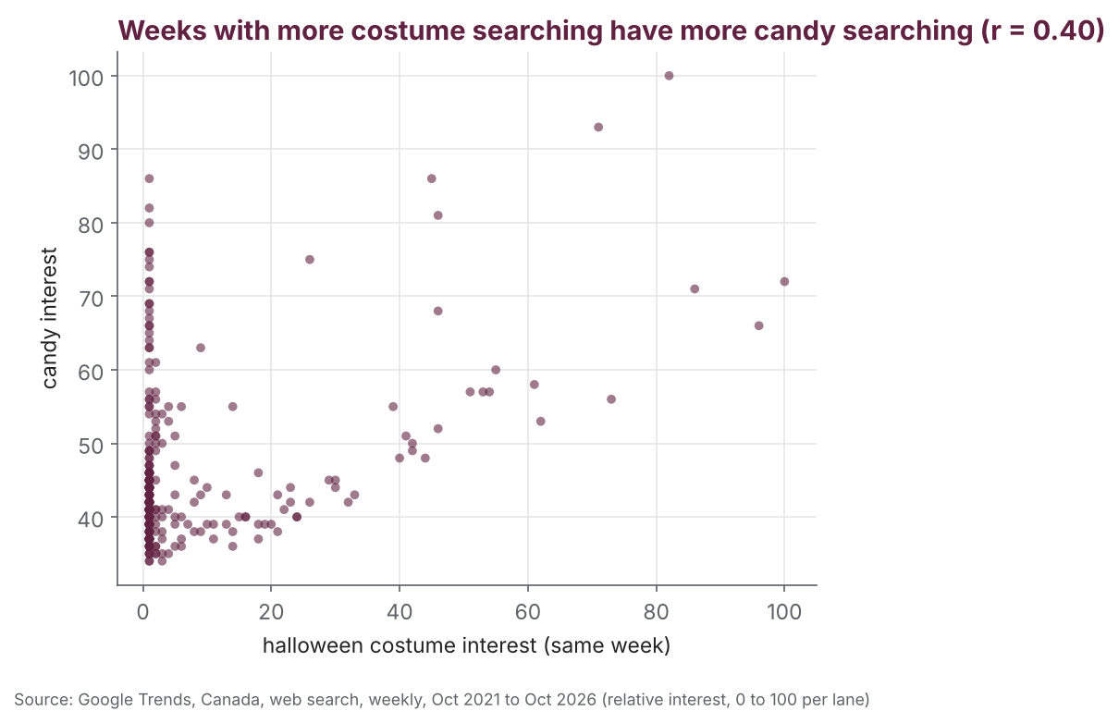
Weeks with more costume searching have more candy searching (r = 0.40)
CHART GALLERY · 6 SCATTER
THE QUESTION
Do costume and candy searches move together?
PANDAS + MATPLOTLIB
ax.scatter(pair["halloween costume"], pair["candy"])
r = pair["halloween costume"].corr(pair["candy"])
WHAT WE CAN INFER
The dots lean up and to the right: r = 0.40, a moderate link. Most weeks are quiet for both; the busy costume weeks are only some of candy's busy weeks, because candy has Christmas too.
THE LIMIT
Not causation. Neither causes the other; the calendar causes both. Say it on your slide if you use a scatter.
Source: Google Trends, Canada, web search, weekly, Oct 24, 2021 to Oct 25, 2026; relative interest 0 to 100 per lane; read Oct 29, 2026

Slide 30
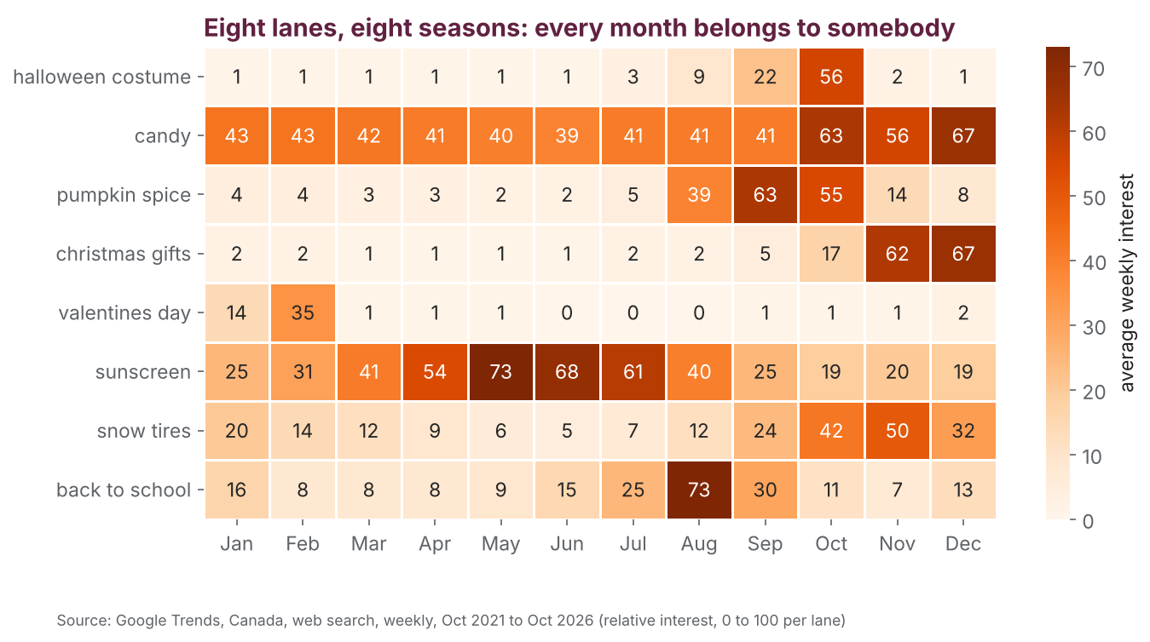
Eight lanes, eight seasons: every month belongs to somebody
CHART GALLERY · 7 HEATMAP
THE QUESTION
What does the whole year look like, for every lane at once?
SEABORN
sns.heatmap(calendar_table, annot=True,
fmt=".0f", cmap="Oranges")
WHAT WE CAN INFER
Read across a row for a lane's season, down a column for who is busy this month. October: costumes, pumpkin spice, snow tires. December: gifts and candy. February: valentines. May to July: sunscreen. August: back to school.
THE LIMIT
Monthly averages blur the exact week; season maths finds the week.
Source: Google Trends, Canada, web search, weekly, Oct 24, 2021 to Oct 25, 2026; relative interest 0 to 100 per lane; read Oct 29, 2026

Slide 31
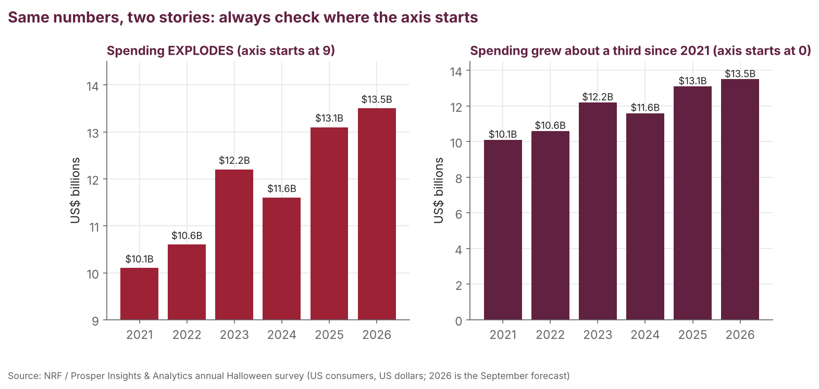
Start bars at zero: an axis starting at 9 turns 34% growth into an explosion
MAKE IT HONEST
Source: NRF / Prosper Insights & Analytics annual Halloween consumer survey (nrf.com Halloween Data Center); US consumers, US dollars; 2026 is the September forecast

Slide 32
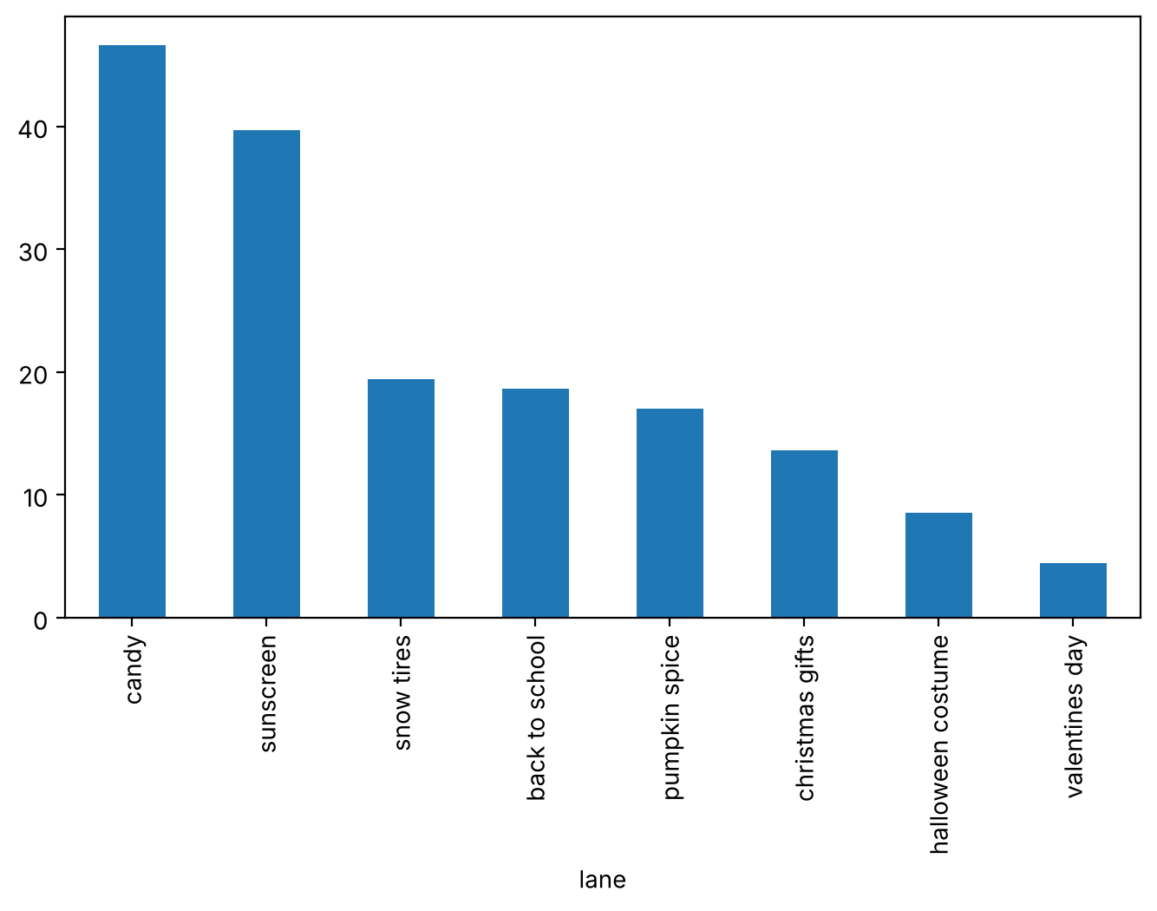
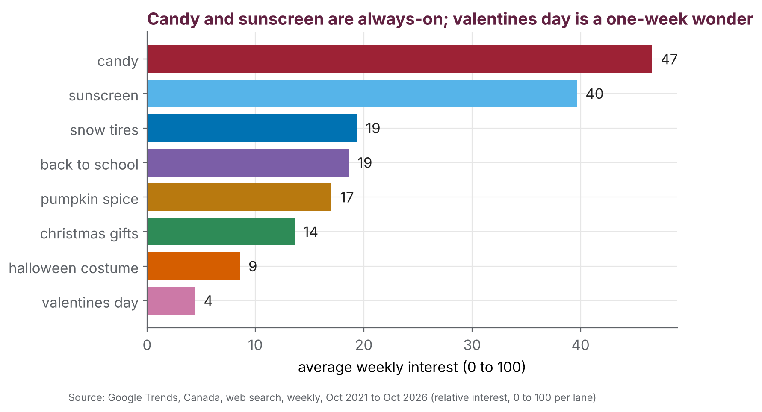
Same numbers, two charts: the second says what it found
MAKE IT HONEST · MAKEOVER
BEFORE: DEFAULTS
AFTER: HOUSE STYLE
1 Title states the finding
2 Labels you can read
3 One colour per lane
4 The number on the bar
5 A source line
Source: Google Trends, Canada, web search, weekly, Oct 24, 2021 to Oct 25, 2026; relative interest 0 to 100 per lane; read Oct 29, 2026

Slide 33
Four rules for every chart you make today
MAKE IT HONEST · THE RULES
1
Bars start at zero
a truncated axis turns a third into an explosion
2
The title states the finding
not the topic: 'Costume season is 3 to 4 weeks', not 'Costume searches'
3
A source line, always
where the numbers came from, and when
4
Say the limit out loud
relative interest, not sales · Canada-wide, not Nova Scotia · US dollars · a survey
A chart without a limit is an ad.

Slide 34
Season maths: the three numbers every pitch needs
04

Slide 35
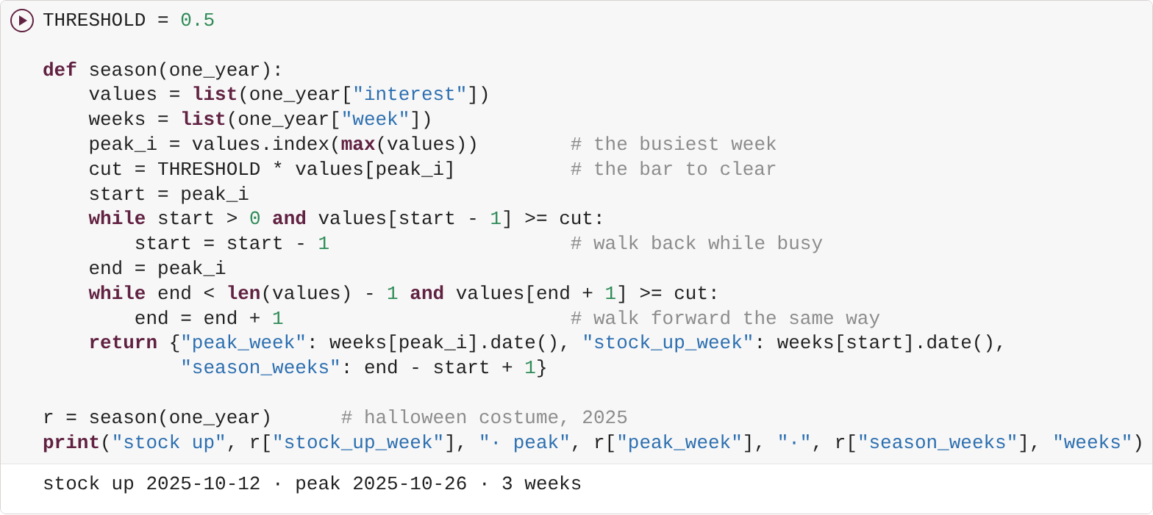
Peak week, stock-up week, season length: a function with two while loops
SEASON MATHS
peak week
the week with the highest score
stock-up week
walking backwards from the peak, the first week still at or above 50% of it. Shelves full by then.
season length
the stretch of weeks around the peak that stay above the bar
✏️ THRESHOLD = 0.5 is a choice you made. Change it, the table changes; say so in your pitch.
Source: Google Trends, Canada, web search, weekly, Oct 24, 2021 to Oct 25, 2026; relative interest 0 to 100 per lane; read Oct 29, 2026

Slide 36
Same every year? The shortest and longest season for every lane
SEASON MATHS · EVERY LANE
Lane | Store | Shortest | Longest | Average | Stock-up weeks (2022 to 2025)
halloween costume | party store | 3 | 4 | 3.5 | Oct 9 · Oct 8 · Oct 6 · Oct 12
candy | convenience store | 12 | 16 | 14 | Sep 11 · Sep 17 · Oct 6 · Oct 5
pumpkin spice | café | 8 | 10 | 9 | Aug 21 · Aug 20 · Aug 18 · Aug 17
christmas gifts | gift shop | 6 | 7 | 6.2 | Nov 13 · Nov 12 · Nov 10 · Nov 16
valentines day | florist / card shop | 1 | 2 | 1.2 | Feb 6 · Feb 12 · Feb 11 · Feb 9
sunscreen | pharmacy | 15 | 23 | 18.5 | Apr 24 · Apr 9 · Mar 31 · Mar 9
snow tires | garage | 2 | 11 | 7.5 | Oct 16 · Sep 24 · Sep 29 · Nov 2
back to school | stationery store | 5 | 5 | 5 | Aug 7 · Aug 6 · Aug 4 · Aug 3
Season length in weeks at the 50% rule, full years only (2021 and 2026 are partial). Stock-up week = first week of the busy stretch.
Source: Google Trends, Canada, web search, weekly, Oct 24, 2021 to Oct 25, 2026; relative interest 0 to 100 per lane; read Oct 29, 2026

Slide 37
Pitch the season
05

Slide 38
Teams of 2 or 3. One lane, one store, one decision backed by charts
PITCH THE SEASON · THE BRIEF
halloween costume
candy
pumpkin spice
christmas gifts
party store
convenience store
café
gift shop
valentines day
sunscreen
snow tires
back to school
florist / card shop
pharmacy
garage
stationery store
THE DECISION
Stock date
Ad start
Markdown date
How to check
shelves full by the stock-up week
a week or two before
after the last busy week
real sales next year, not searches
Chart rule 2 or 3 charts from section 6; at least one box plot, heatmap, histogram or scatter; every chart with a title that states the finding, a source, and one honest limit said out loud.

Slide 39
Title + 3 slides, emailed by 12:10
PITCH THE SEASON · SLIDES AND SUBMISSION
YOUR SLIDES
SEND ONE OF THESE
0
Title
A PowerPoint
your lane, your store, your team's names
your 4 slides, charts pasted from the Files panel
1
What we did
A Google Slides link
one cell explained line by line (5a or 6a is a good pick)
shared so Gavin can open it
An AI-built HTML dashboard
2
What the data proves
attached as an .html file. Encouraged!
2 or 3 charts, at least one box plot / heatmap / histogram / scatter, and one honest limit
3
Want an AI-built dashboard? Dashboard Skill.md is on the download page. Paste your season table or month table from step 6f, not the raw data.
The decision, and how we used AI
stock date, ad start, markdown date, how you'd check it; what the AI did and how you checked it
AI rules (Day 2): no personal information · run it yourself · the AI can be wrong.

Slide 40
16 points: one row per slide, plus delivery
PITCH THE SEASON · RUBRIC
Criterion | 4 | 3 | 2 | 1
What we did (slide 1): explain one cell | Walks through one cell line by line and says why each line is needed | Explains what it does, with small gaps | Reads the code aloud without explaining it | Can't explain it
What the data proves (slide 2): charts | A clear claim, 2 or 3 readable charts (at least one box plot, heatmap, histogram or scatter) from real output, and one honest limit | Claim + charts, but bar or line only, or no limit | Claim with a weak or unlabelled chart | Opinion only, no chart
The seasonal decision (slide 3) | Stock date, ad start and markdown date that follow from the charts, plus how to check it with real sales | Dates given, weakly tied to the charts, or no way to check | Vague ("stock up in the fall") | Missing
Delivery, time and use of AI | Everyone speaks, within 3 min; says what the AI did and how they checked it | Everyone speaks; slightly over time or thin on checking | One speaker dominates, or no AI checking | Unprepared or well over time

Slide 41
Eight teams, three minutes each, in season order
PITCH THE SEASON · PRESENTATIONS
1
back to school
2
halloween costume
3
candy
4
pumpkin spice
stationery store
party store
convenience store
café
5
christmas gifts
6
valentines day
7
snow tires
8
sunscreen
gift shop
florist / card shop
garage
pharmacy
3 minutes each: everyone on the team speaks; the decision slide gets the most time.

Slide 42
We built a program that analyzes and visualizes data to support a business decision.
Python lets us refine insights and prove a decision.
Next Friday: how generative AI writes, and you design an AI assistant.

